Slide 1

More on Funds

Slide 2
Mutual Funds
Pool money from investors to purchase stocks, bonds, and other assets
Either passively or actively managed
Net Asset Value (NAV): price per share -- computed at the end of each trading day
Investors pay (or receive) the next available NAV when buying (selling)
Downsides to investors
  Fees → next slide
  Capital gain treatment -- when the fund sells securities, the capital gains are passed on to the mutual fund investors in a year-end distribution

Slide 3
Mutual Funds (cont’d.)
Two types of fees:
  Annual operating fees
    expressed as a fraction of the investment value in the expense ratio
    range from 0.015% to 2%
  Shareholder fees
    stem from purchasing and selling mutual fund shares
    include front-end loads for purchases, back-end loads and/or redemption fees for sales, and broker commissions

Slide 4
Exchange Traded Funds (ETFs)
Similar to mutual funds, but
  trade continuously on exchanges during trading hours
  more likely to be passive (and, thus, have lower fees)
  exploit a loophole in the tax code to avoid passing on capital gains to investors

Slide 5
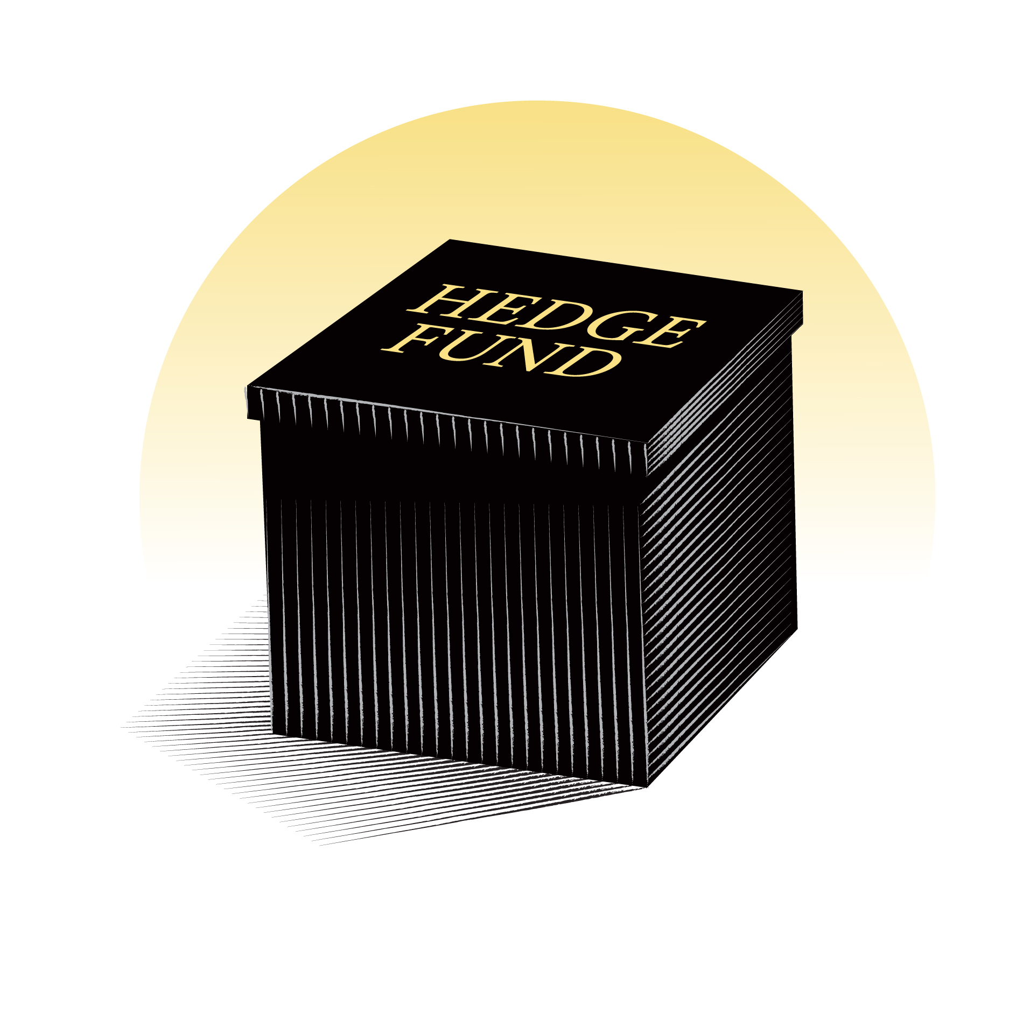
Hedge Funds
Actively managed
Unlike mutual funds:
  no investment restrictions
  no disclosure requirements → black box
  only offered to accredited investors
High fees, e.g., “2-and-20”
Notes:
The SEC defines an accredited investor through the confines of income and net worth in two ways:
A natural person with income exceeding $200,000 in each of the two most recent years or joint income with a spouse exceeding $300,000 for those years and a reasonable expectation of the same income level in the current year.
A natural person who has an individual net worth, or joint net worth with the person’s spouse, that exceeds $1 million at the time of the purchase, excluding the value of the primary residence of such person.
On Aug. 26, 2020, the SEC amended the definition of an accredited investor -- individuals will be permitted to participate in our private capital markets not only based on their income or net worth, but also based on measures of financial sophistication:
- Individuals who have certain professional certifications, designations, or credentials
- Individuals who are “knowledgeable employees” of a private fund
- SEC- and state-registered investment advisers

Slide 6
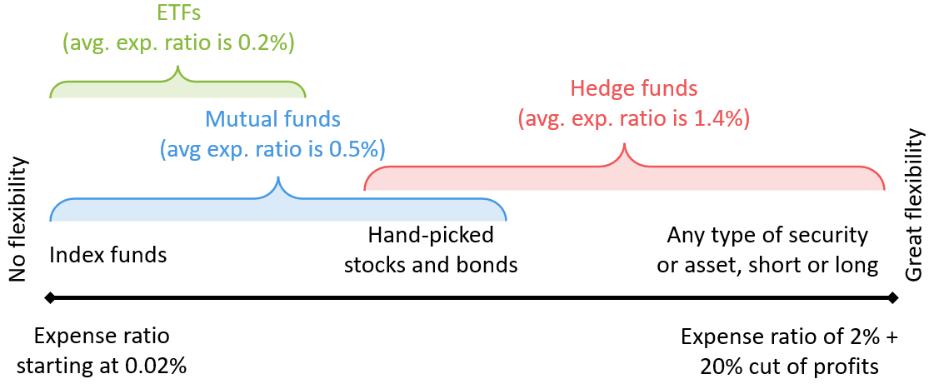
Comparison of Funds – A Simplification

Slide 7
The Effect of Fees
Notes:
the value of a $1,000 investment with an annual return of 8% after 30 years for different fee levels

Slide 8

Concept Test
Avery is very wealthy, yet very risk averse. Although he is a so-called accredited investor who could invest in hedge funds, he has decided to bypass them in favor of ETFs -- he simply views hedge funds to be too risky.
Do you agree with Avery’s assessment?
Notes:
Avery is generally correct in his assessment of risk; despite their names, hedge funds are typically more aggressive than mutual funds and ETFs.
But:
there is great variation in the risk level of hedge funds
there are many ETFs that are also very risky, including many of those that focus on narrow sectors or small countries, or those that use leverage to boost performance
→ Avery should choose an ETF with a broad portfolio and no leverage.

Slide 9

Concept Test 2
Not in book
Why are target date funds more suited for a retirement account than for a regular brokerage account?
Notes:
As stated in the Vanguard article about the huge tax bills that came out of nowhere: Spokeswoman Carolyn Wegemann said that because the Target Retirement approach seeks to reduce risk over time by automatically trimming stock positions, “these funds are best served in a tax-deferred account.”

Slide 10
Ready-Made Funds
Many financial institutions, including Vanguard, offer “ready-made funds.”
Designed to match your
  investment horizon (lifecycle funds) or
  risk tolerance (lifestyle funds)
Type of Fund of Funds (FOF)
Upside: convenience
Downside: fees might incur at two levels

Slide 11
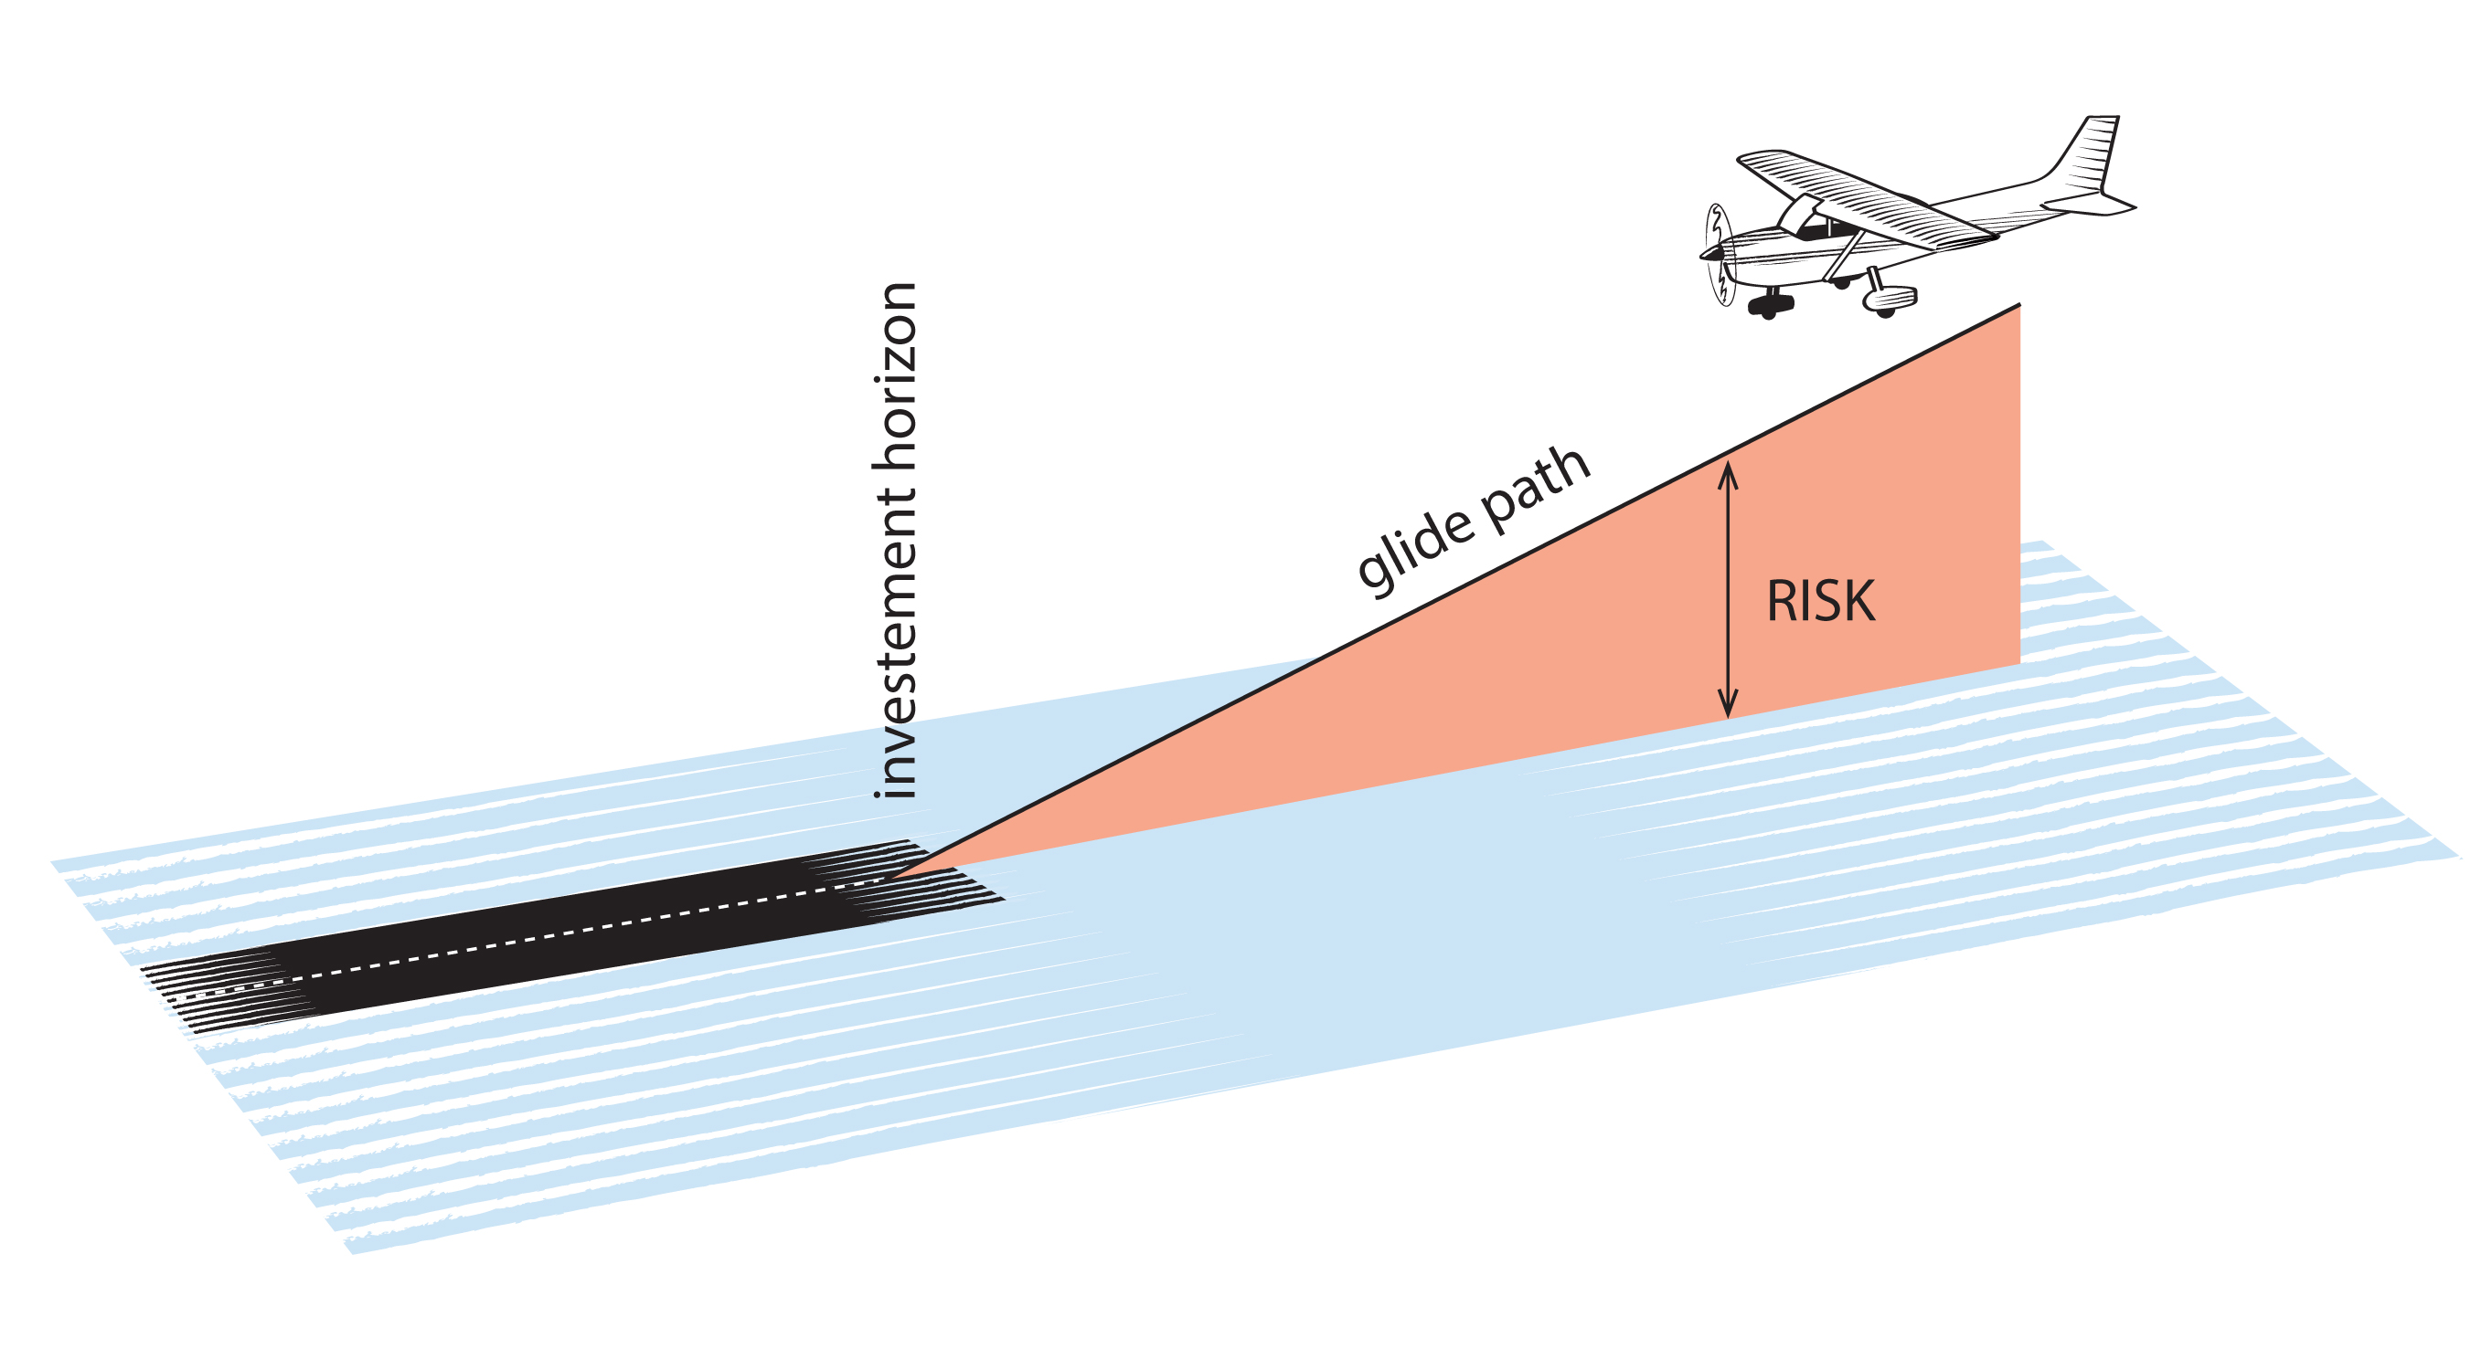
Target Date Funds (aka Lifecycle Funds)
designed to fit certain investment horizons, or target dates (usually retirement)
gradually reduce the risk along a glide path by reallocating away from stocks and toward bonds
often the default in retirement accounts

Slide 12
Vanguard’s Target Retirement Fund

Slide 13
Target Risk Funds (aka Lifestyle Funds)
Unlike lifecycle funds, the asset allocation remains constant
Vanguard’s target-risk funds below

