Slide 1

Tax Strategies

Slide 2

Taxes on Employment Income
Notes:
High
Progressive

Slide 3
Taxes on Investment Income
Notes:
Lower, but still progressive

Slide 4
Taxes on Investment Income (cont’d.)
 | Interest income | Dividends | Capital gains
Favored tax rate |  | Qualified dividends | Realized long-term capital gains
Employment income tax rate | Most interest income (with possible exceptions for Treasury and municipal bonds) | Non-qualified dividends | Realized short-term capital gains
Notes:
Qualified: generally, dividends from US companies that investor has held stock for 60 days
Long-term capital gains – holding period > one year

Slide 5
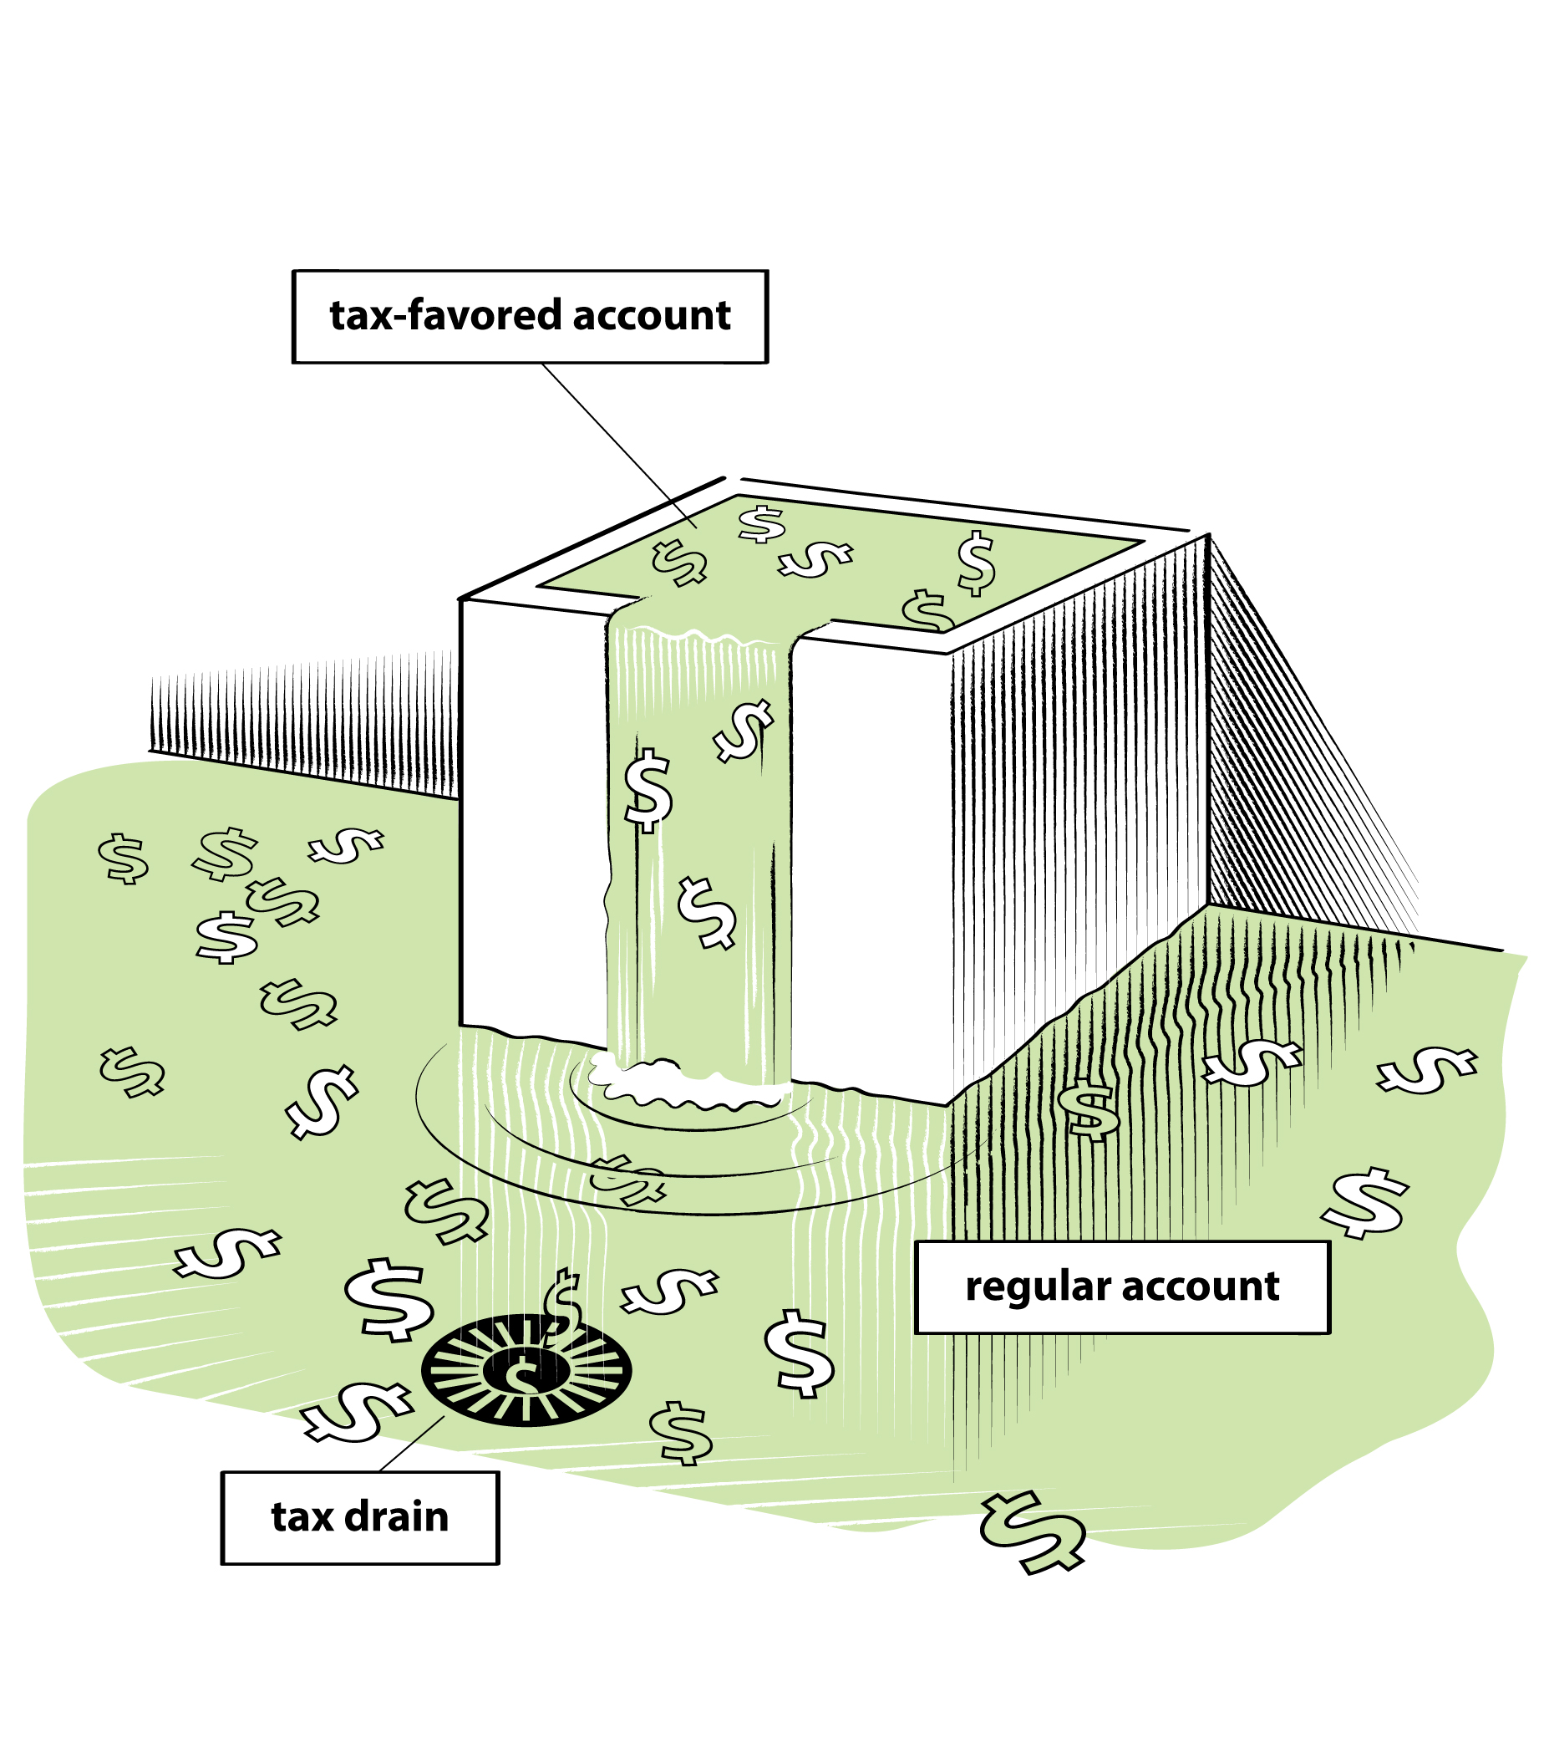
Account Types
Regular (non-tax-favored) brokerage accounts
Tax-favored accounts
  Effectively no taxes on investment income
  Includes retirement accounts and college savings accounts
  Come with limits, so funds might spill over into regular accounts

Slide 6
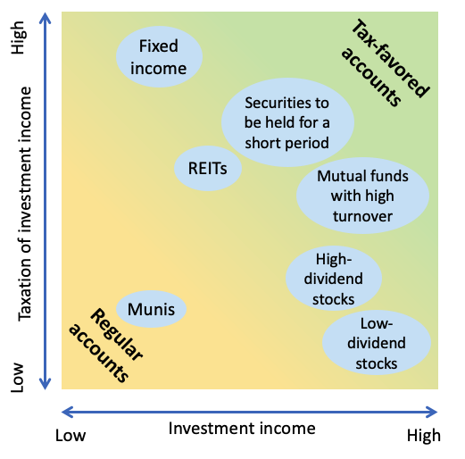
Asset Location: What to Keep Where

Slide 7

How to Minimize Taxes in Regular Accounts
Bad news: we generally cannot keep all our securities in tax-favored accounts
Good news: many ways to reduce the tax burden of securities in regular accounts

Slide 8

Extend the Holding Period
Extend the holding period of investments with large capital gains for two reasons:
  capital gains change status from “short-term” to “long-term” after one year → lower tax rate
  the capital gains taxes are deferred

Slide 9
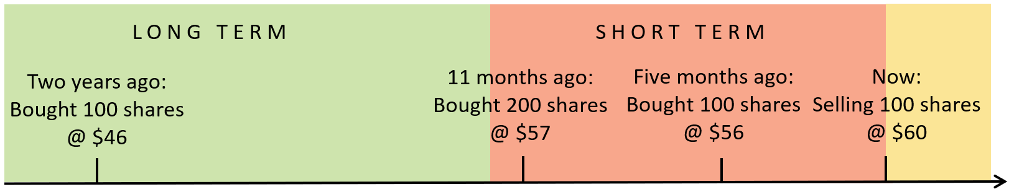
Choose the Optimal Tax Lot
Exploit the flexibility in choosing which stocks to sell. Generally:
  Sell shares with the highest basis price
  Sell shares held for at least a year
In the example below, it appears to be best to sell the shares that were bought 11 months ago.
These guidelines can clash, as in the example below

Slide 10
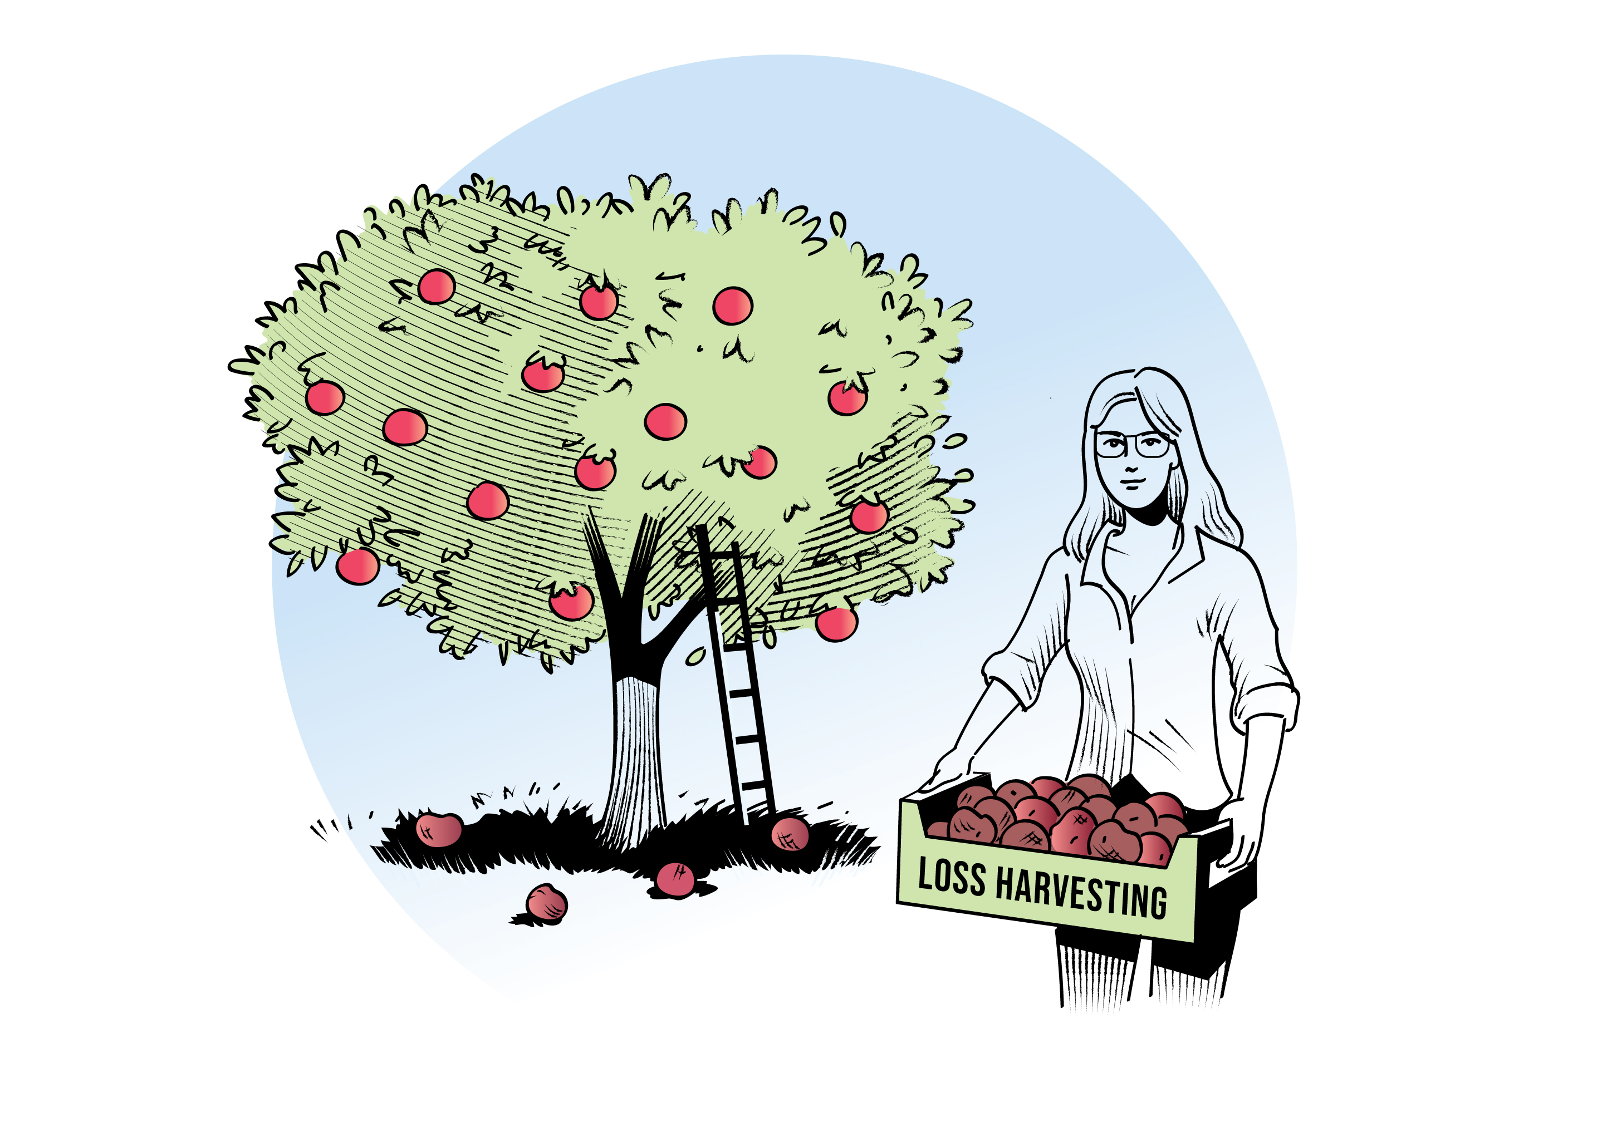
Harvest Capital Losses
Realized capital losses can be used to offset realized capital gains, and then up to $3,000 in taxable income annually.
Any residual realized capital losses can be carried forward indefinitely until they are used up.
With an income tax rate of 30%, using capital losses of $3,000 to offset taxable income saves 30% × $3,000 = $900 in taxes that year.

Slide 11

A Warning for Loss Harvesting:
The Wash-Sale Rule
A wash sale is a sale of a security at a loss combined with a repurchase of the same (or very similar) security within 30 days.
To claim the loss for tax purposes, investors must wait at least 31 days before repurchasing the same security.

Slide 12

Harvest Capital Gains
Recall that the tax rate on realized long-term capital gains drops to zero if your income < $40K.
→ if your income temporarily falls, e.g., because you take a sailboat trip around the world, consider selling some of your securities that have accumulated long-term capital gains

Slide 13

When You Need Liquidity
Periodically you need to tap into your brokerage accounts for funds, e.g., because you need equity for a house purchase.
If so, you should identify a collection of securities in your brokerage account to sell that collectively have no net capital gain.

Slide 14

Stock Donations
Donating stock with capital appreciation is generally more tax efficient than donating cash.
Example – donate $10,000 to Doctors Without Borders
  A cash donation will cost you, well, $10,000. (And you can claim a tax deduction afterward.)
  Donating stock worth $10,000 that you bought for $6,000 will effectively cost you less than $10,000. Why? Because the stock has an imbedded tax liability on the $4,000 capital gain.
Caveat: If the stock is held for more than a year, you can claim a tax deduction of $10,000. But, if the stock was held for less than a year, you can only claim a deduction of $6,000.

Slide 15

Stock Gifts
You may gift stocks to other individuals.
The recipient takes over both
  the holding period and
  the responsibility for paying capital gains taxes on the gain when (s)he sells the stock.
Gifting stock reduces the total tax bill across the giver and the recipient if
  the stock has accumulated capital gains at the time of gifting, and
  the recipient faces a lower tax rate on capital gains than the giver.

Slide 16
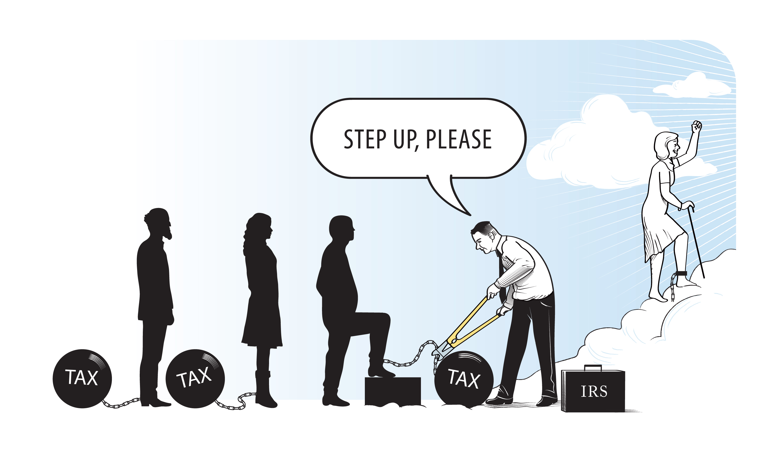
Bequest Stock to Your Heirs
When someone inherits stocks (or other investments), the basis is reset to equal the market value upon the original owner’s death.
The stepped-up basis effectively wipes out the capital gains, and you can sell the stocks immediately without having to pay any capital gains taxes.

Slide 17

Hold a Portfolio of Individual Securities
There are tax advantages to holding individual securities rather than a fund that holds the individual securities.
The variation in return across individual securities makes it easier to pursue the tax strategies discussed earlier, e.g., loss harvesting.

Slide 18





Summary: Treatment of Capital Gains/Losses
Not in book
Gift
Capital gain is passed on
Thus, the decision should consider the capital gains tax rate of recipient.
Capital gain
Capital gain is wiped out (step-up in basis)
Inheritance
Gift
Capital loss is not passed on
Try to use capital losses yourself before death
Capital loss
Inheritance
Capital loss is wiped out (step-down in basis)

Slide 19
Concept Test 1
Not in book
You have three stocks in your portfolio. Stock A has performed very well, with a capital gain of 200%. Stock B has performed very poorly, with a capital gain of –50%. Stock C has not changed in value since you bought it.
  Which stock would you give to charity?
  Which stock would you give to an unemployed friend in financial straits?
  Which stock you would you sell for liquidity (e.g., to buy a new car)?
Notes:
Which stock would you give to charity? A
Which stock would you give to an unemployed friend in financial straits? A or C
Which stock you would you sell for liquidity (e.g., to buy a new car)? B or C

Slide 20
Concept Test 2
Not in book
Alex claims that it makes more sense to use accumulated capital losses as a potential way to wash out realized capital gains in the future than to harvest losses to offset employment income.
What do you think?
Notes:
It is generally preferable to use capital losses to offset employment income first because the tax rate on employment income is generally higher than the tax rate on capital gains, especially on long-term capital gains. (Also, it is better to get tax breaks as soon as possible so that you can invest this money for further gains.) Of course, the tax code only allows to offset a little more than $3K of employment income, so it is usually possible to also offset capital gains.

Slide 21
Concept Test 3
Steve does not like the strategy of harvesting capital losses – he says that the investment objective should be to make money, not lose money.
What do you think?
Notes:
Of course, the objective should be to make money. But even if that is your objective, you will inevitably lose money on some positions if you hold many different positions. Harvesting capital losses can therefore help you make more post-tax money by reducing the tax bill.

Slide 22
Concept Test 4
Not in book
Twin brothers Cole and Oscar invested $100,000 in three stocks each from different sectors. Cole’s three stocks have all doubled to a value of $200,000 each. Oscar’s three stocks have had more uneven performance, with one having increased to $500,000, one not having changed, and the last having defaulted with trivial remaining value.
Which is the better position?
Notes:
Cole currently has the more diversified position, assuming that the three stocks have little correlation, despite all having doubled in value since he bought them. (You could, alternatively, argue that Oscar’s position is more diversified because of the lower correlation between the securities suggested by the past performance.) But Oscar has more opportunities for reducing taxes, including loss harvesting and liquidating part of the portfolio without realizing net capital gains.

Slide 23
Netting Rules for Gains and Losses
Step 1 Calculate net ST capital gain (loss) and net LT capital gain (loss) separately
Step 2 Net the LT gain or loss against the ST gain or loss
Step 3 Any remaining net capital loss (whether ST or LT) can be used to reduce ordinary income up to $3,000
Step 4 Treatment of the remainders after the prior steps:
net ST gain: taxed at ordinary income tax rate
net LT gain: taxed at favorable investment income tax-rate
net ST loss: carried over indefinitely (retains its ST classification)
net LT loss: carried over indefinitely (retains its LT classification)

Slide 24


Examples of Netting
Not in book
ST gain = $5,000
ST loss = $2,000
LT gain = $4,000
LT loss = $5,000
➔ Net ST gain = $3,000
➔ Net ST gain = $2,000
➔ Net LT loss = $1,000
ST gain = $5,000
ST loss = $2,000
LT gain = $4,000
LT loss = $15,000
➔ Net ST gain = $3,000
➔ Net LT loss = $8,000
➔ Net LT loss = $11,000
Reduce ordinary income by $3,000
Carry over LT loss of $5,000

Slide 25
Concept Tests
Not in book
William has realized $5,000 of ST capital gains in the current tax year so far. If he also intends to sell some securities at a loss of $5,000, does it matter whether they have been held for more than a year?
Mary has realized $5,000 of ST capital gains and $5,000 of LT capital gains in the current tax year so far. If she also intends to sell some securities at a loss of $5,000, does it matter whether they have been held for more than a year?
Notes:
William: No
Mary: Yes – she should sell securities that have been held for less than a year. But she really should try to realize losses of $10,000, in which case it would not matter.

Slide 26
An Extensive Example
The remaining slides cover an extensive example based on a portfolio of individual stocks in a regular brokerage account.
BOOM ↑ 0.33% BUD ↑ 1.54% CAKE ↓ –0.42% CAR ↓ –0.29% CASH ↑ 0.99% EAT ↓ –3.51% EYES ↑ 1.31% FIZZ ↑ 0.03% FUN ↓ –0.44% HEAR ↓ –1.88% HOG ↓ –0.79% JOB ↑ 0.17%

Slide 27
Portfolio of Individual Stocks
 | End 2018 | End 2019 | One-year return | End 2020 | One-year return
BOOM | 34.72 | 44.71 | 29% | 43.25 | -3%
BUD | 63.63 | 81.26 | 28% | 69.91 | -14%
CAKE | 41.68 | 38.42 | -8% | 37.06 | -4%
CAR | 22.48 | 32.24 | 43% | 37.30 | 16%
CASH | 19.15 | 36.32 | 90% | 36.56 | 1%
EAT | 41.93 | 41.55 | -1% | 56.57 | 36%
EYES | 7.09 | 5.94 | -16% | 1.87 | -68%
FIZZ | 67.42 | 47.93 | -29% | 84.90 | 77%
FUN | 43.18 | 54.25 | 26% | 39.34 | -27%
HEAR | 14.27 | 9.45 | -34% | 21.55 | 128%
HOG | 32.24 | 36.63 | 14% | 36.70 | 0%
JOB | 0.70 | 0.39 | -44% | 1.00 | 156%
LUV | 45.68 | 53.77 | 18% | 46.61 | -13%
MOO | 55.55 | 67.97 | 22% | 77.89 | 15%
PETS | 21.27 | 22.66 | 7% | 32.06 | 41%
PLOW | 33.85 | 53.22 | 57% | 42.77 | -20%
PZZA | 38.67 | 62.45 | 62% | 84.85 | 36%
ROCK | 35.59 | 50.44 | 42% | 71.94 | 43%
SAVE | 57.92 | 40.31 | -30% | 24.45 | -39%
SEED | 5.17 | 5.36 | 4% | 15.19 | 183%
SHOO | 29.62 | 42.78 | 44% | 35.32 | -17%
TAP | 53.52 | 53.29 | 0% | 45.19 | -15%
WATT | 5.79 | 1.77 | -69% | 1.80 | 2%
WIFI | 20.57 | 10.95 | -47% | 12.72 | 16%
XRAY | 36.60 | 56.06 | 53% | 52.36 | -7%
ZEUS | 14.09 | 17.80 | 26% | 13.33 | -25%
SPY | 240.78 | 315.96 | 31% | 373.88 | 18%
Suppose that at the end of 2018 you invest $1,000 in each of the first 20 stocks from the list to the right.
Prices are given at the end of 2018, 2019, and 2020 so that we can see how to harvest losses and undertake other opportunistic transactions.
Invest in these at the end of 2018
Invest in these later
ETF for S&P 500 for comparison

Slide 28
 | End 2018 | End 2019
 | Buy | Value before transactions | Gain/Loss since purchase | In % | Sell (if loss >$100) | Harvested losses | Buy | Donate | Value after transactions
BOOM | $1,000 | $1,288 | $288 | 29% | $0 |  |  |  | $1,288
BUD | $1,000 | $1,277 | $277 | 28% | $0 |  |  |  | $1,277
CAKE | $1,000 | $922 | -$78 | -8% | $0 |  |  |  | $922
CAR | $1,000 | $1,434 | $434 | 43% | $0 |  |  |  | $1,434
CASH | $1,000 | $1,897 | $897 | 90% | $0 |  |  | $1,000 | $897
EAT | $1,000 | $991 | -$9 | -1% | $0 |  |  |  | $991
EYES | $1,000 | $837 | -$163 | -16% | $837 | -$163
FIZZ | $1,000 | $711 | -$289 | -29% | $711 | -$289
FUN | $1,000 | $1,256 | $256 | 26% | $0 |  |  |  | $1,256
HEAR | $1,000 | $662 | -$338 | -34% | $662 | -$338
HOG | $1,000 | $1,136 | $136 | 14% | $0 |  |  |  | $1,136
JOB | $1,000 | $557 | -$443 | -44% | $557 | -$443
LUV | $1,000 | $1,177 | $177 | 18% | $0 |  |  |  | $1,177
MOO | $1,000 | $1,224 | $224 | 22% | $0 |  |  |  | $1,224
PETS | $1,000 | $1,065 | $65 | 7% | $0 |  |  |  | $1,065
PLOW | $1,000 | $1,572 | $572 | 57% | $0 |  |  |  | $1,572
PZZA | $1,000 | $1,615 | $615 | 62% | $0 |  |  |  | $1,615
ROCK | $1,000 | $1,417 | $417 | 42% | $0 |  |  |  | $1,417
SAVE | $1,000 | $696 | -$304 | -30% | $696 | -$304
SEED | $1,000 | $1,037 | $37 | 4% | $0 |  |  |  | $1,037
SHOO |  |  |  |  |  |  | $1,411 |  | $1,411
TAP |  |  |  |  |  |  | $1,411 |  | $1,411
WATT |  |  |  |  |  |  | $1,411 |  | $1,411
WIFI |  |  |  |  |  |  | $1,411 |  | $1,411
XRAY |  |  |  |  |  |  | $1,411 |  | $1,411
ZEUS |  |  |  |  |  |  | $1,411 |  | $1,411
 | $20,000 | $22,772 | $2,772 |  | $3,464 | -$1,536 | $8,464 | $1,000 | $26,772
We sell shares with losses of at least $100 to realize total losses of $1,536. (We could have sold shares with losses below $100 also, but the additional benefit is small.)
We buy six shares using the sales proceeds of $3,464 + another $5,000.
We donate $1,000 in shares of the stock that has the greatest percentage gain since purchase.

Slide 29
Benefits of Strategic Trades
Tax-loss harvesting: You may use capital losses in excess of capital
gains to offset ordinary taxable income up to $3,000 in any one tax year.
  In our case, we were only able to harvest $1,536 in losses.
  It would be advantageous to harvest $3,000 if possible (or even more, because net capital losses in excess of $3,000 can be carried forward indefinitely until it is exhausted). With a larger portfolio or a worse portfolio performance, we would have been able to do that.
  Assuming we have an income of $100,000 and a tax rate of 30%, we should ordinarily pay $30,000 in taxes.
    Harvesting capital gains losses of $1,536 reduces our taxable income to $98,464 and our taxes to $29,539.
    Thus, we were able to save $460 in taxes. (This can also be calculated as 30% × $1,536 = $460, and had we been able to harvest losses of $3,000, the tax savings would have been 30% × $1,536 = $900.)
  Note that had we invested all our money in the market index fund SPY instead, we would not have been able to harvest any losses.

Slide 30
Benefits of Strategic Trades (cont’d.)
Stock donations: When donating stock, you can bypass capital
gains taxes.
  In our case, we donated $1,000 stock that had increased in value by about 90% since the purchase.
  In other words, we had originally paid about $1,000 / 1.9 = $526 for that stock, and the remainder $474 was capital gains.
  If we were to sell that stock and then donate the proceeds, we would have had to pay capital gains taxes of about $474 × 15% = $71, and we would only have had $1,000 – $71 = $929 left to donate.
  If we alternatively donate $1,000 from our cash balance, we still have the $1,000 of stock that we would have to pay capital gains taxes on in the future.

Slide 31
 | End 2020
 | Value before transactions | Gain/Loss last year | Gain/Loss since purchase | In % | Sell (if loss >$100) | Harvested losses | Buy | Donate | Value after transactions
BOOM | $1,246 | -$42 | $246 | 25% | $0 |  |  |  | $1,246
BUD | $1,099 | -$178 | $99 | 10% | $0 |  |  |  | $1,099
CAKE | $889 | -$33 | -$111 | -11% | $889 | -$111 |  |  | $0
CAR | $1,659 | $225 | $659 | 66% | $0 |  |  |  | $1,659
CASH | $903 | $6 | -$97 | -10% | $0 |  |  |  | $903
EAT | $1,349 | $358 | $349 | 35% | $0 |  |  |  | $1,349
EYES |  |  |  |  |  |  | $1,861 |  | $1,861
FIZZ |  |  |  |  |  |  | $1,861 |  | $1,861
FUN | $911 | -$345 | -$89 | -9% | $0 |  |  |  | $911
HEAR |  |  |  |  |  |  | $1,861 |  | $1,861
HOG | $1,138 | $2 | $138 | 14% | $0 |  |  |  | $1,138
JOB |  |  |  |  |  |  | $1,861 |  | $1,861
LUV | $1,020 | -$157 | $20 | 2% | $0 |  |  |  | $1,020
MOO | $1,402 | $178 | $402 | 40% | $0 |  |  |  | $1,402
PETS | $1,507 | $442 | $507 | 51% | $0 |  |  |  | $1,507
PLOW | $1,263 | -$309 | $263 | 26% | $0 |  |  |  | $1,263
PZZA | $2,194 | $579 | $1,194 | 119% | $0 |  |  |  | $2,194
ROCK | $2,021 | $604 | $1,021 | 102% | $0 |  |  |  | $2,021
SAVE |  |  |  |  |  |  | $1,861 |  | $1,861
SEED | $2,938 | $1,901 | $1,938 | 194% | $0 |  |  | $1,000 | $1,938
SHOO | $1,165 | -$246 | -$246 | -17% | $1,165 | -$246
TAP | $1,196 | -$214 | -$214 | -15% | $1,196 | -$214
WATT | $1,435 | $24 | $24 | 2% | $0 |  |  |  | $1,435
WIFI | $1,639 | $228 | $228 | 16% | $0 |  |  |  | $1,639
XRAY | $1,318 | -$93 | -$93 | -7% | $0 |  |  |  | $1,318
ZEUS | $1,056 | -$354 | -$354 | -25% | $1,056 | -$354
 | $29,349 | $2,577 | $5,885 |  | $4,307 | -$925 | $9,307 | $1,000 | $33,349
We sell shares with losses of at least $100 to realize total losses of $925.
We buy five shares using the sales proceeds of $4,307 + another $5,000. (Note that in this case we can buy some of the stock that we sold the year before without violating the wash-sale rule.)
We donate $1,000 in shares of the stock that has the greatest percentage gain since purchase.

Slide 32
Other Strategic Trades
What if you had no income in 2019?
  If you had no or very low income, your tax rate would be zero on both your income and capital gains.
  If so, there is no benefit in 2019 to harvest losses (though you could do it to carry forward the losses to future years when you expect to have income).
  Rather, you should consider engaging in tax-gain harvesting, in which you sell shares with a capital gain now without paying any capital gains tax. If you wait until later, there is a good change that your tax rate will increase and you would have to pay taxes on any realized capital gains.
  Notes:
    If you realize a very large capital gain, you might be moved into a positive tax bracket, thus negating the benefit.
    The wash-sale rule does not apply to tax-gain harvesting, so you could repurchase the stock shortly after you sold them.
Notes:
Long-term capital gains can’t push your ordinary income into a higher tax bracket, but they may push your capital gains rate into a higher tax bracket.

Slide 33
Other Strategic Trades (cont’d.)
What if you needed more liquidity in 2020?
  You certainly did not have to invest the sale proceeds of $4,307 and the additional $5,000 that year.
  Furthermore, you could liquidate additional stock. If so, you should strive to sell stock with a net capital gain close to zero. Reasonable alternatives include the following:
    Sell FUN at $911; capital loss = $89
    Sell XRAY at $1,318; capital loss = $93
    Sell LUV at $1,020; capital gain = $20
    Sell WATT at $1,435; capital gain = $24
    Sell BUD at $1,099; capital gain = $99
    Selling all of these would give proceeds of $5,783 and a net capital loss of $39. Thus, the capital gains tax consequence from this would be minimal. (In this case, it would actually provide a slight additional tax break.)

Slide 34

Other Strategic Trades (cont’d.)
Warning: This step-up in basis upon inheritance is a tax loophole that might disappear one day -- perhaps the inheritance might even trigger an immediate capital gains tax based on the original basis.
At some point, you end up with only stocks that have large accumulated gains left in your portfolio. What do you do then?
  In that case, you might have to “bite the bullet” and realize capital gains if you need to liquidate more funds. (At least you were able to postpone the tax bill, as if you used the government money to fund your investments for a while.)
  But if you do not need the remaining funds, you could pass them on to your heirs, in which case the accumulated capital gains evaporate. (That is, the basis of the securities is reset to the current value.)

