Slide 1

Market Efficiency & Investment Psychology

Slide 2
Market Efficiency
Market efficiency means that security prices reflect all available, relevant information.
(Semi-strong efficiency narrows it down to public information.)
→ it is worthless for investors to seek out and analyze information with the goal of finding undervalued stocks
→ active management is worthless – it does not generate alpha beyond passive management (indexing)
Notes:
Very important concept for financial markets.
It does not mean that the market knows it all or that it can predict the future perfectly. For example, the market did not fully see the financial crisis coming.

Slide 3
The Evidence on Active Management
Actively managed funds fail to deliver superior returns.
  High operating costs → high fees for investors
  Active trading induces substantial costs (imbedded in prices)
  Managers might keep the best trades for themselves

Slide 4
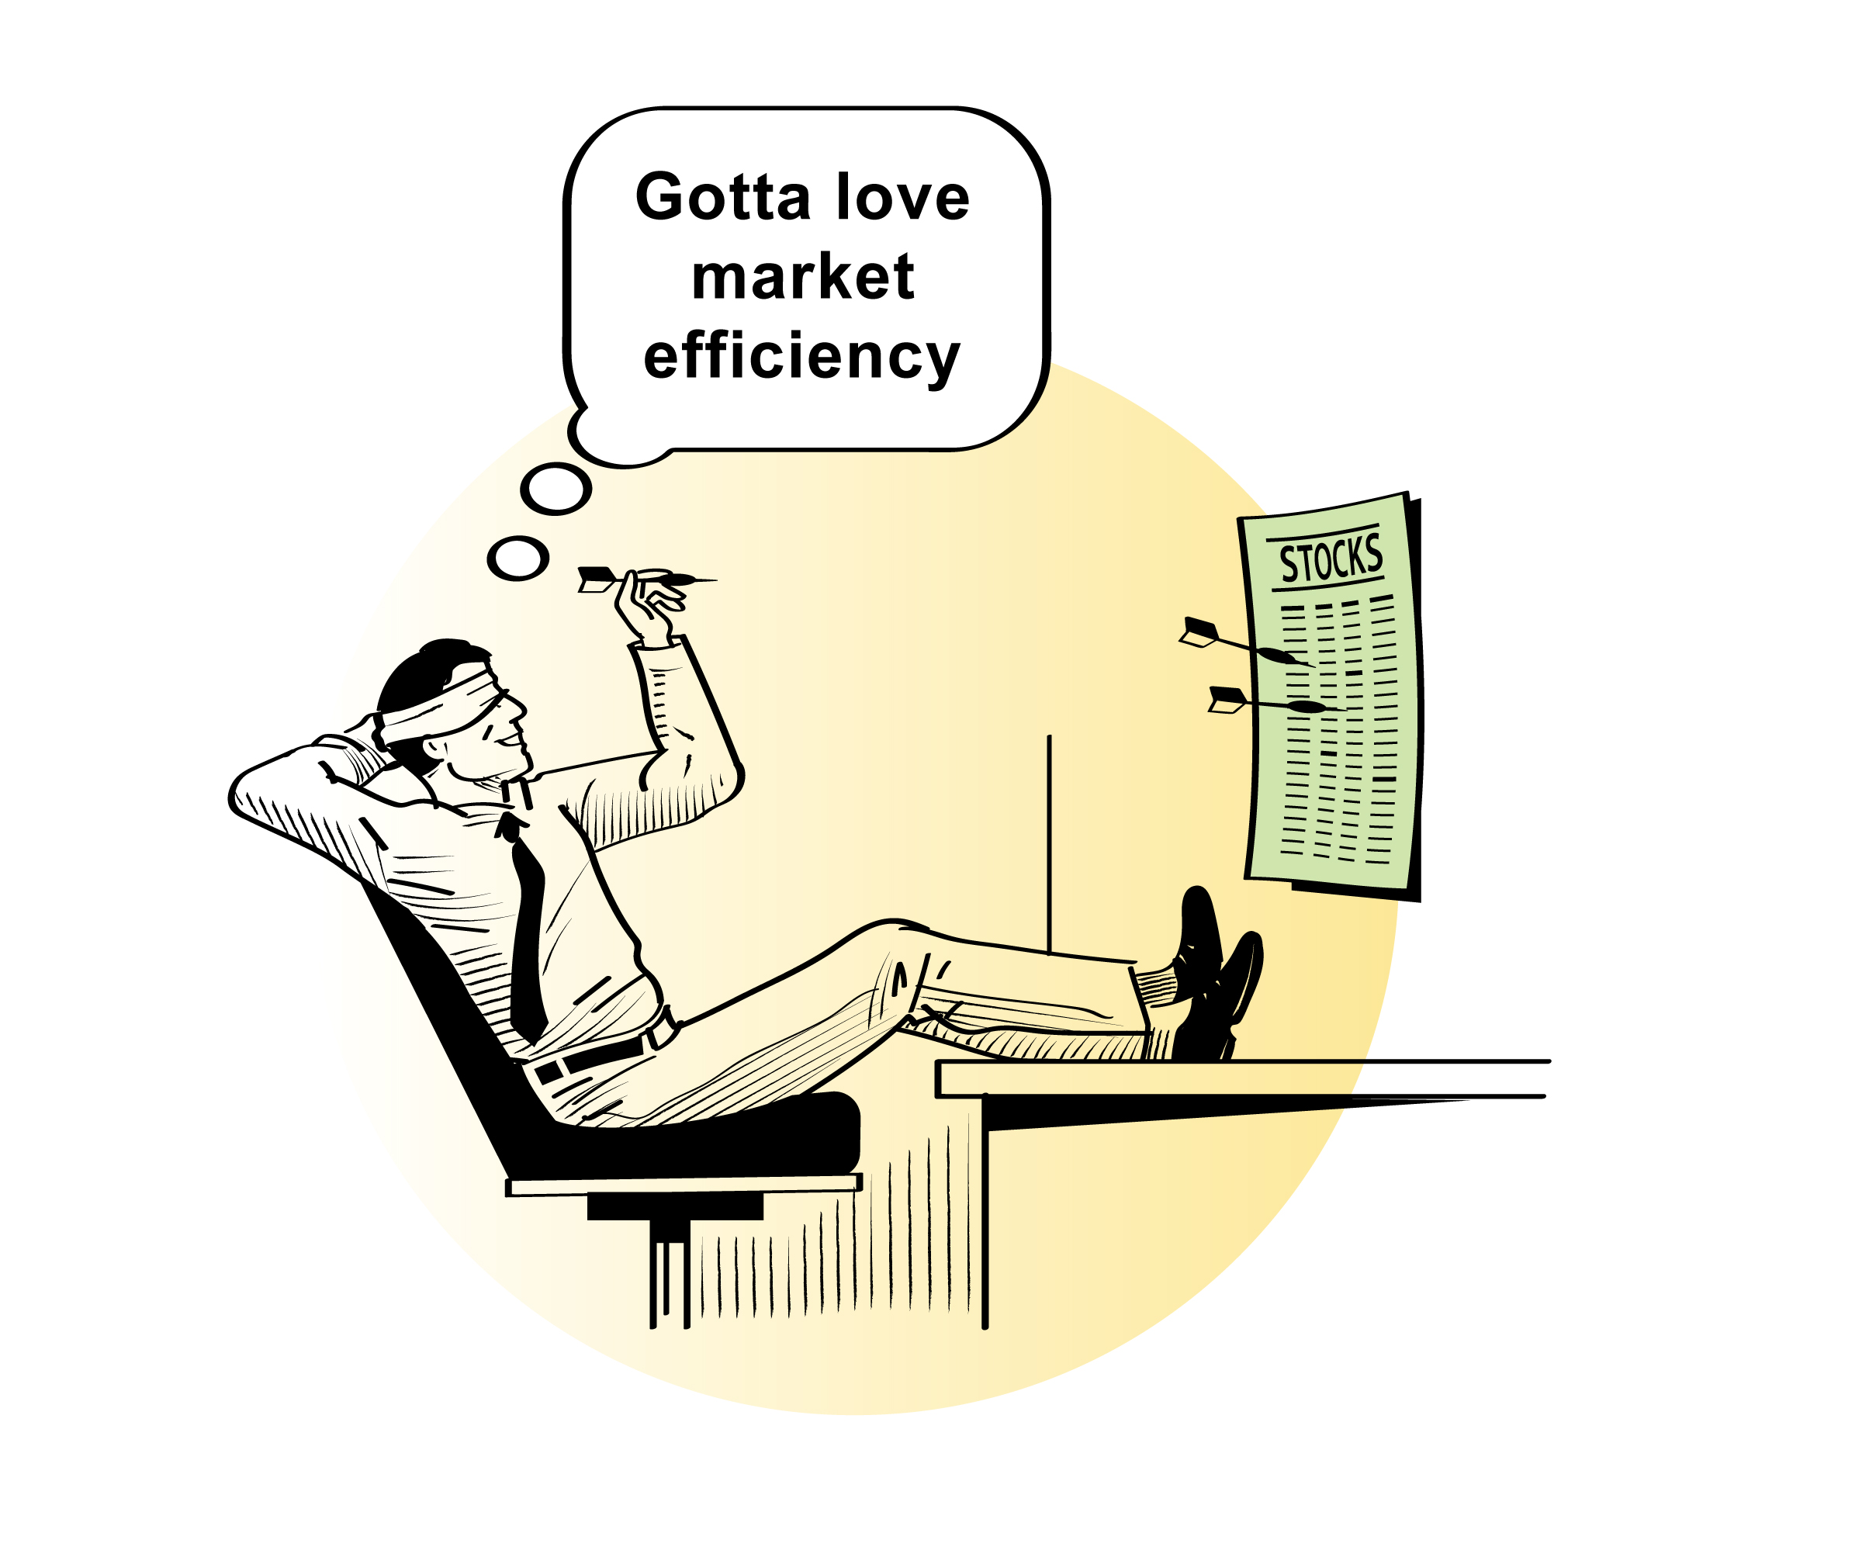
Implications for Individual Investors
invest in index funds, and/or
randomly choose stocks (as long as you end up with a diversified portfolio with desired risk profile)

Slide 5

Concept Test
Not in book
Suppose that you believe the stock market to be efficient after having participated in the market for years.
In contrast, your friend, Toby, collects and invests in old toys as a way to accumulate wealth. He does not feel comfortable investing in the stock market, because he has much less expertise about the stock market than the toy market.
What would you tell Toby to persuade him to transfer some money to the stock market?
Notes:
Some keys:
Stock market is forgiving to those with little understanding.
Stock market allows further diversification of his investment portfolio.

Slide 6
Investment Psychology
Individual investors often behave irrationally → detrimental to wealth
Thus, we should recognize and avoid behavioral investor traps
Notes:
The field of economics used to assume that individuals behave rationally. Not so in reality.

Slide 7

Overconfidence
Investors tend to be overconfident, leading to several problems:
  Excessive trading -- think day traders
    High trading costs
    High taxes
  Excessive risk
Notes:
Most people believe they are above average drivers…
Overconfidence can be useful and a reason for many startups.

Slide 8

Herding and FOMO
Social interactions, FOMO, and herding lead to several problems:
  Vulnerability to schemes (including pump and dump)
  Excessive trading
  Excessive exposure to local economy or certain sectors
  (see also familiarity bias)
Notes:
Social interactions are generally good. But listening to your friends for investment advice is not.
Keep your friends, but do not take their investment advice.

Slide 9
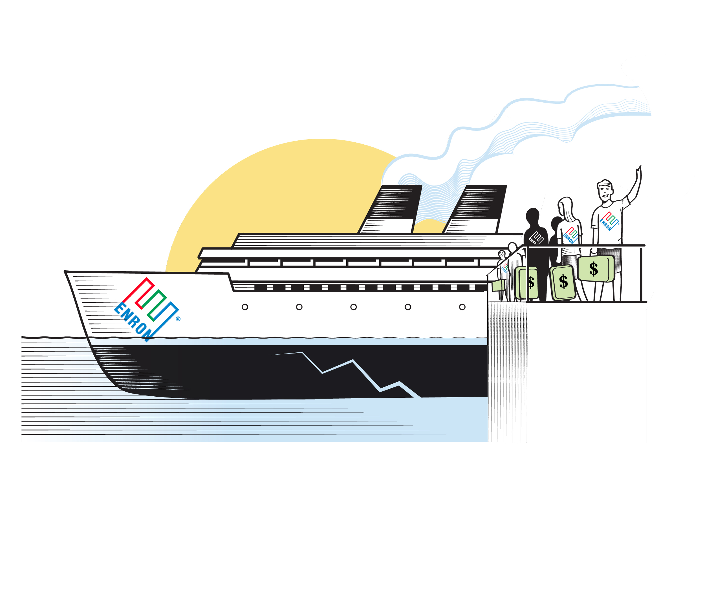
Familiarity Bias
Individuals tend to invest in stocks with which they are familiar.
Consequences:
  home bias
  insufficient diversification
Take a lesson from employees at Enron who invested their retirement savings with the company

Slide 10
Extrapolation Bias
Individuals extrapolate from the past, especially the most recent past.
Extrapolating recent returns cause problems:
  chasing of stocks and funds with good returns
  → poor diversification – i.e., excessive investment in sector with good returns
  excessive optimism after market run-ups

Slide 11
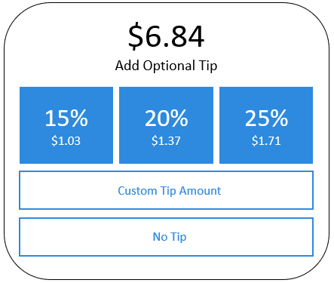
Framing
We are affected by the framing of questions & decisions
Framing is problematic in pension decisions, because individuals might:
  go with the default; opt-out if that is the default
  end up with excessive risk if there are more high-risk options available, and vice versa
  be overwhelmed with too many choices → procrastination
Notes:
Bold blue boxes draw attention; condition us to believe that a tip of 15-25% is ok for a small coffee and a muffin

Slide 12
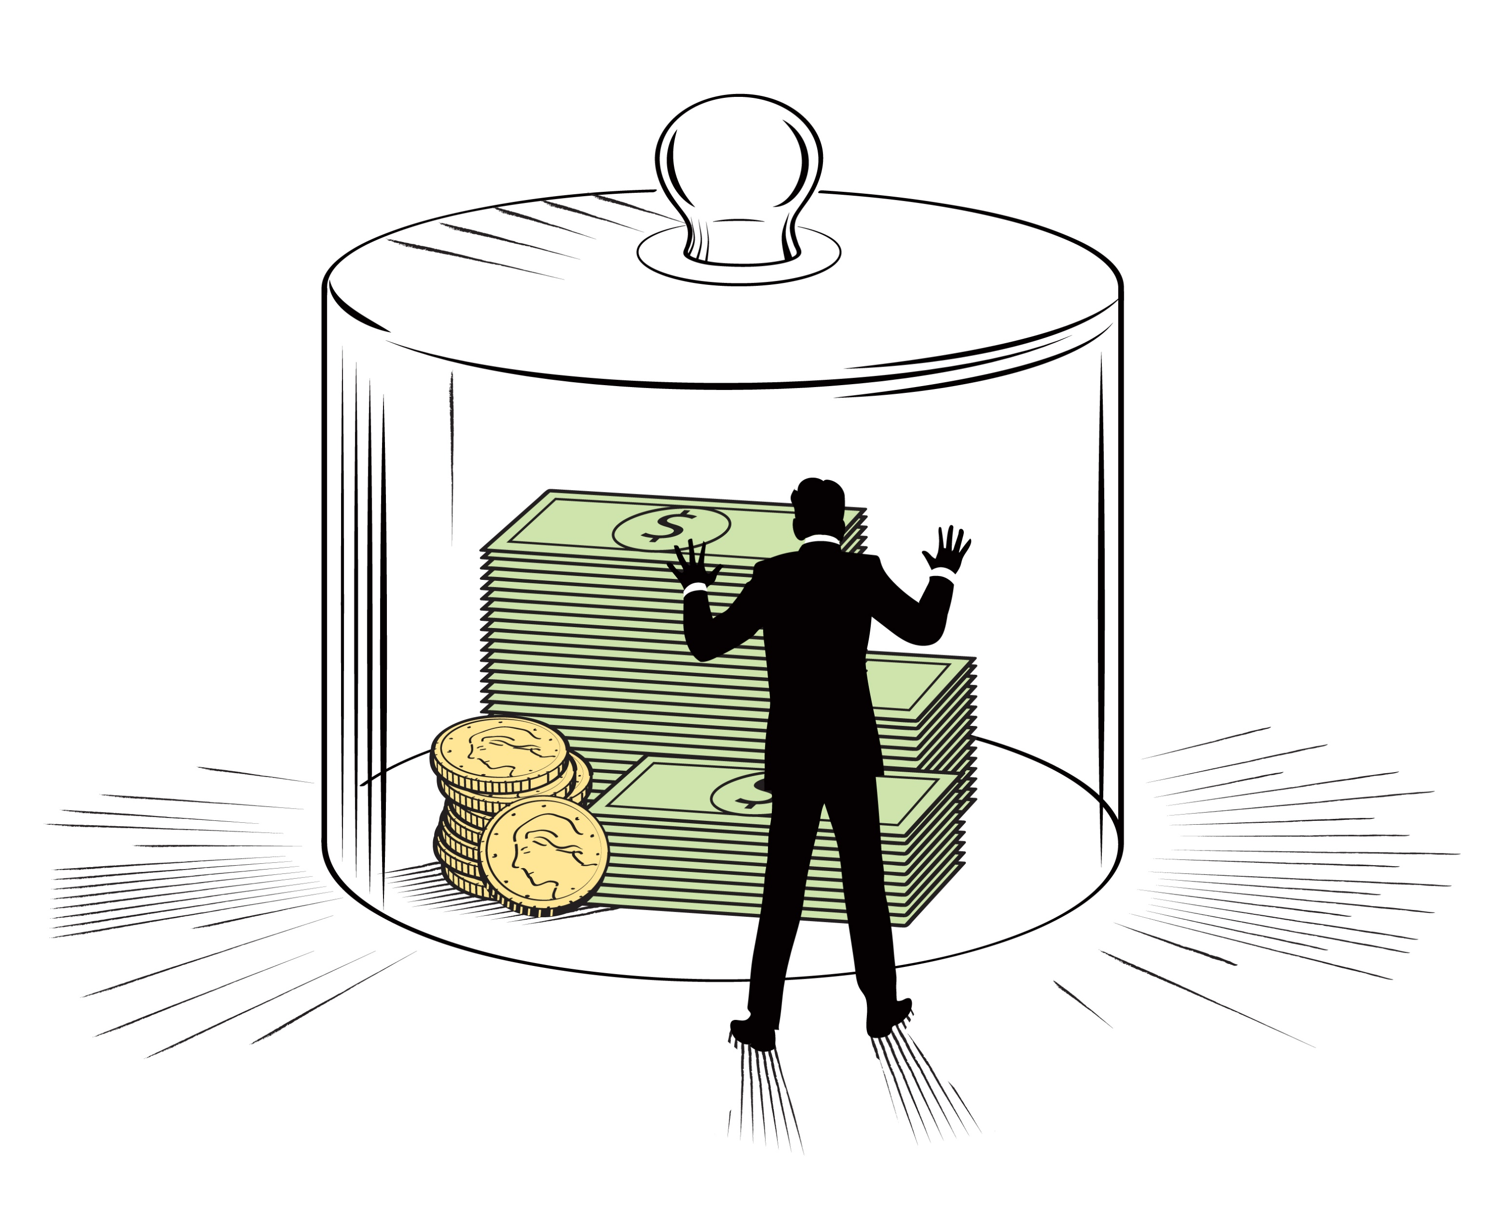
Lack of Self-Control
We all lack self-control to some extent → we need discipline
For saving money:
  discipline via automatic deductions from paycheck toward retirement account, which creates a barrier between you and your savings

Slide 13
The Disposition Effect and What to Sell
Investors are inclined to sell winning stocks and hold on to losing ones
Problem: higher taxes

