Slide 1
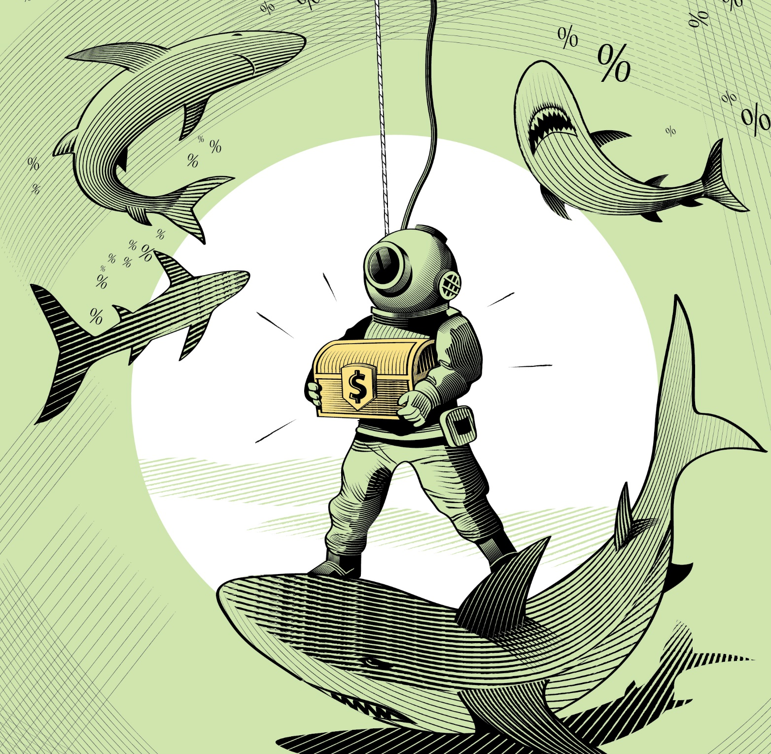
Investment Returns & Investment Principles

Slide 2

Investment Returns
Capital gain (or loss)
$$Investment return=\frac{End price−Beginning price}{Beginning price}+\frac{Cash distributions from the security}{Beginning price}$$
Volatile
Stable
Notes:
The driving force behind accumulating wealth

Slide 3
Investment Returns for Bonds and Stocks
Returns for bonds
Returns for stocks
Capital gains
Volatile
Dividends
Distributions (coupon payments)
Stable
Capital gains

Slide 4
Bonds – Capital Gains

Slide 5
Bonds – Capital Gains (cont’d.)
BUT…
a pro-rated portion of their price gain must be reported as interest for tax purposes

Slide 6
Stocks – Capital Gains and Dividends

Slide 7
The Historical Record

Slide 8
The Historical Record (cont’d.)
Notes:
This risk-return tradeoff is at the foundation of the capital markets

Slide 9

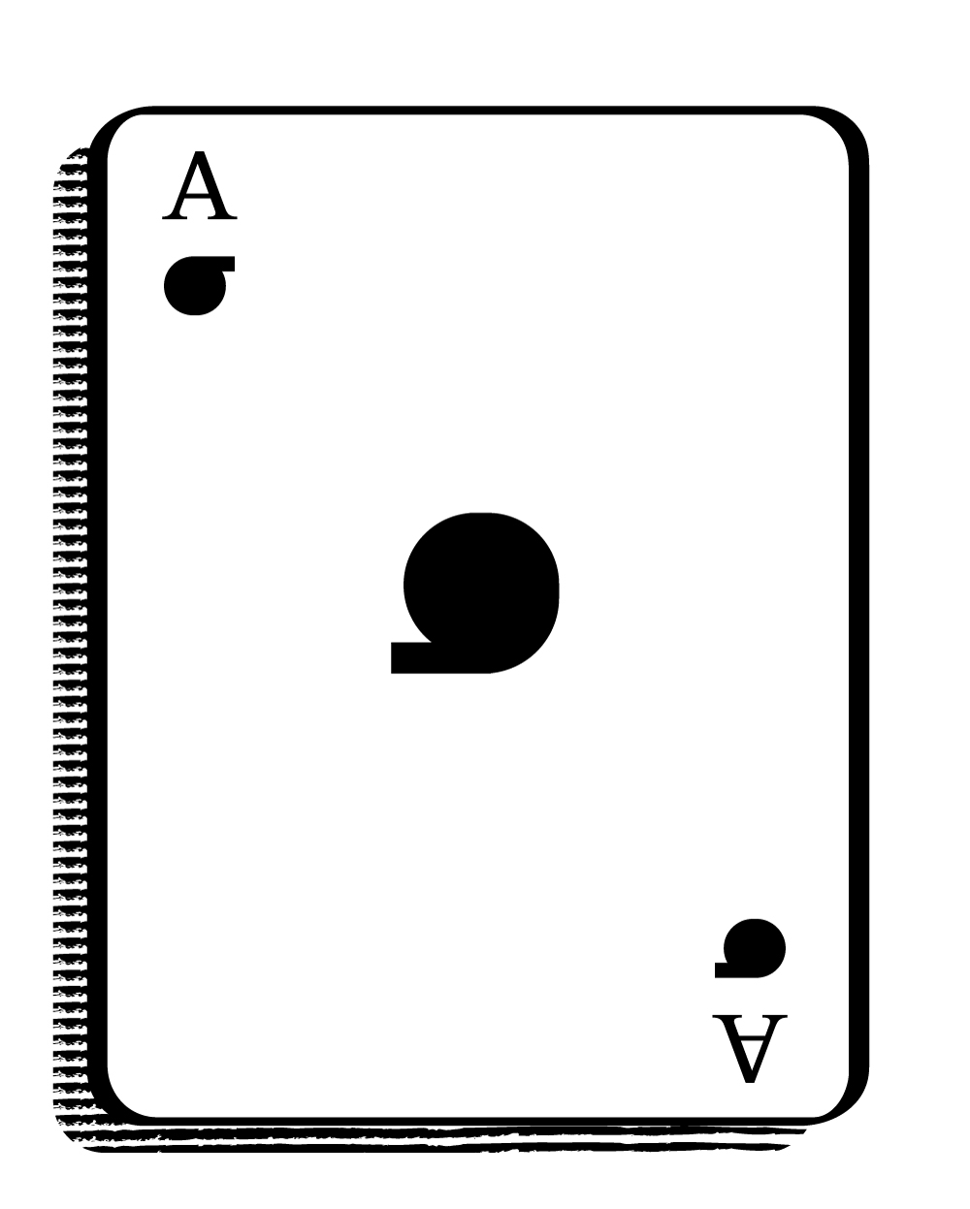
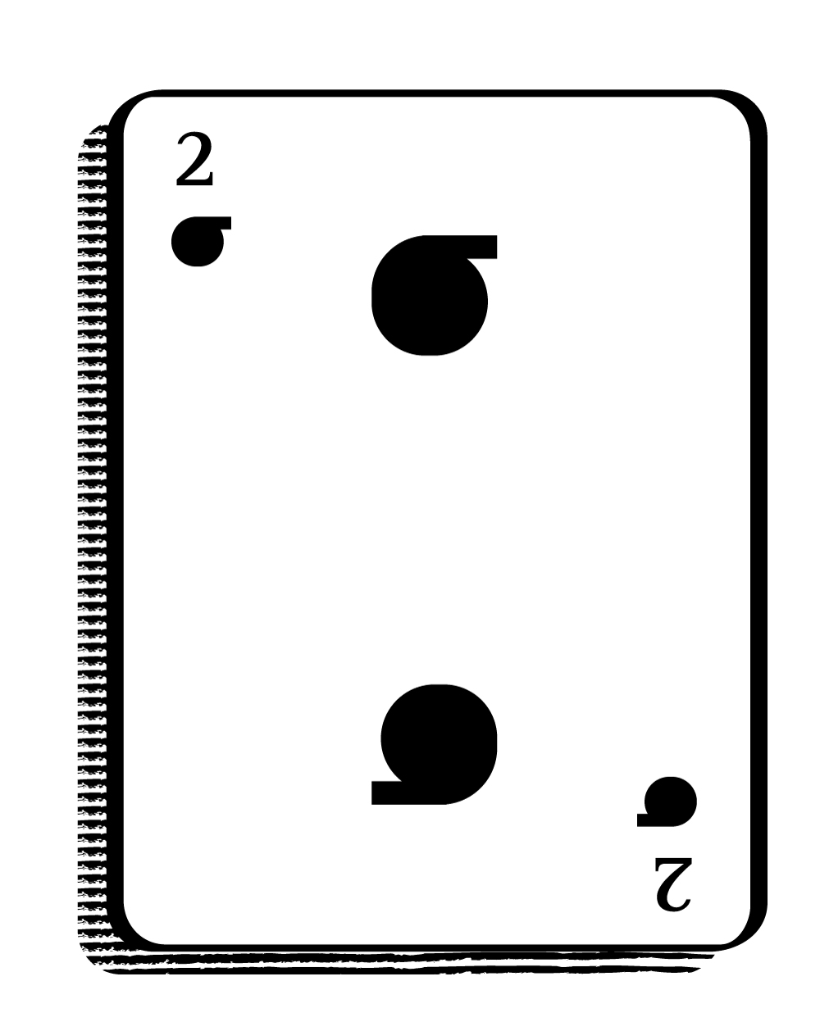
The Magic of Sigma (σ)
The standard deviation of security returns (usually denoted by the Greek letter σ) behaves in curious ways, across both
  securities (i.e., when we form portfolios), and
  time (i.e., when we invest for the longer term).
These behaviors have important implications for how we should invest.

Slide 10
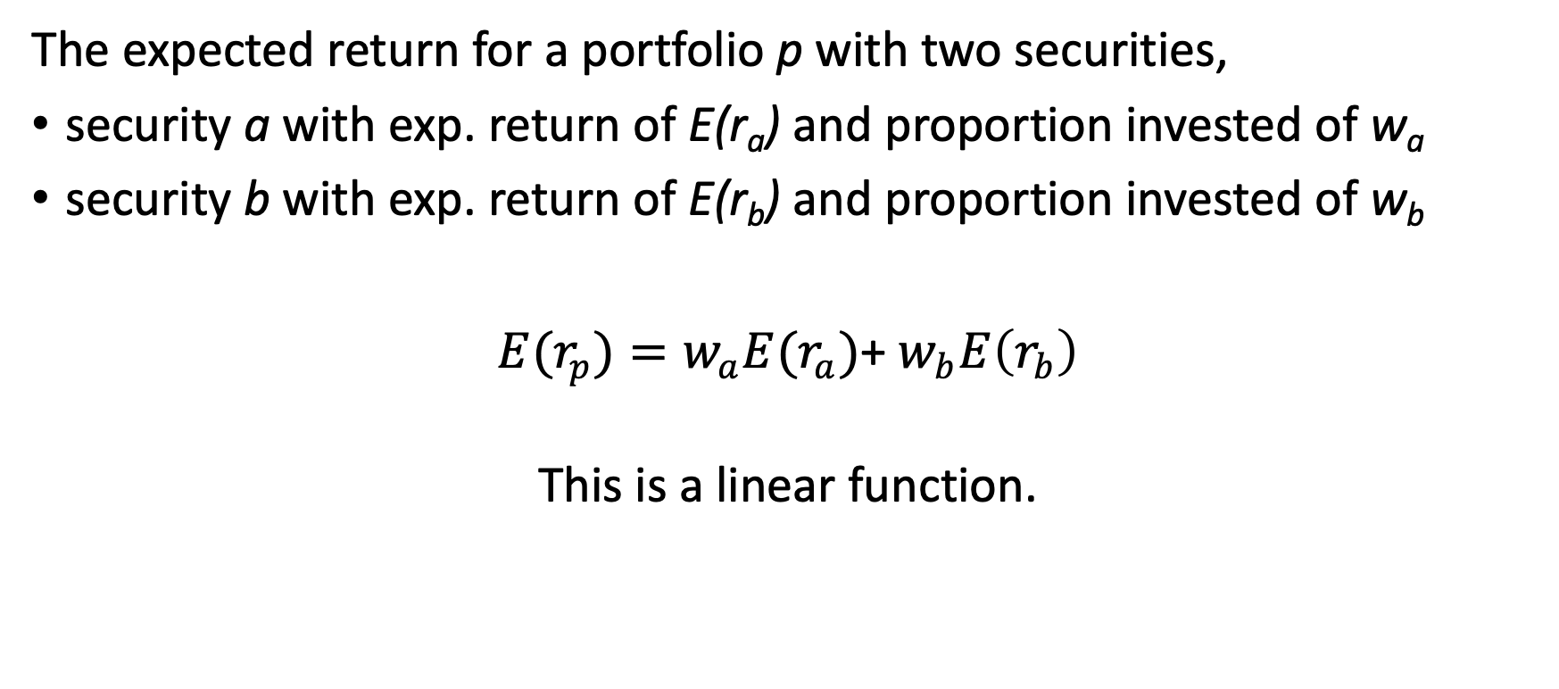
Expected Return for a Portfolio of Two Securities
The expected return for a portfolio p with two securities,
security a with exp. return of E(r_{a}) and proportion invested of w_{a}
security b with exp. return of E(r_{b}) and proportion invested of w_{b}
$E(r_{p})=w_{a}E(r_{a})$+ $w_{b}E\left(r_{b}\right)$
This is a linear function.

Slide 11
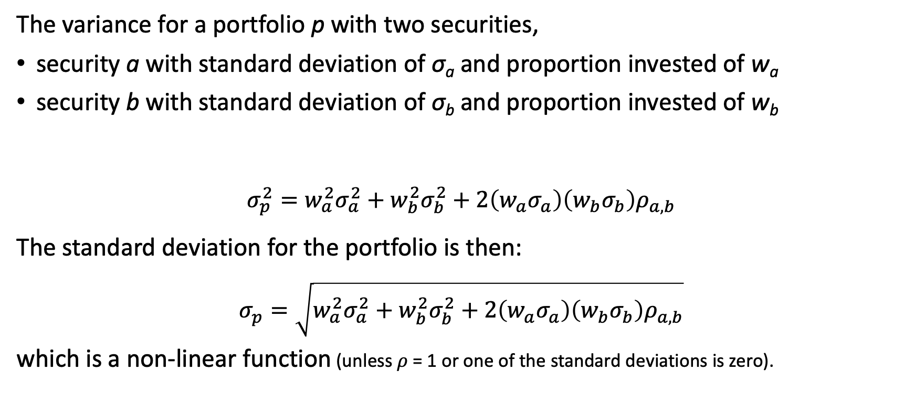
Standard Deviation for a Portfolio of Two Securities
The variance for a portfolio p with two securities,
security a with standard deviation of σ_{a} and proportion invested of w_{a}
security b with standard deviation of σ_{b} and proportion invested of w_{b}
$$σ_{p}^{2}=w_{a}^{2}σ_{a}^{2}+w_{b}^{2}σ_{b}^{2}+2\left(w_{a}σ_{a}\right)\left(w_{b}σ_{b}\right)ρ_{a,b}$$
The standard deviation for the portfolio is then:
$$σ_{p}=\sqrt{w_{a}^{2}σ_{a}^{2}+w_{b}^{2}σ_{b}^{2}+2\left(w_{a}σ_{a}\right)\left(w_{b}σ_{b}\right)ρ_{a,b}}$$
which is a non-linear function (unless 𝜌 = 1 or one of the standard deviations is zero).
Correlation between securities a and b.

Slide 12
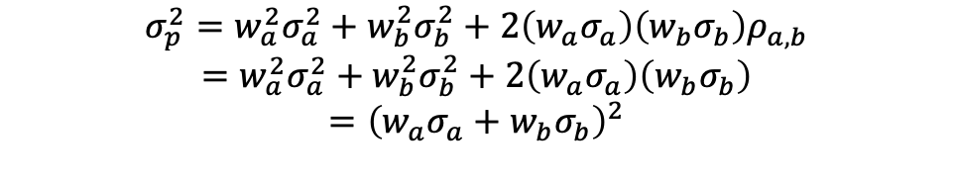

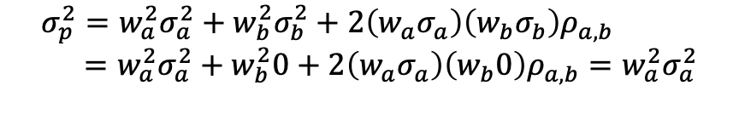
The Standard Deviation for a Portfolio (cont’d.)
SPECIAL CASE where $ρ_{a,b}$=1:
$$σ_{p}^{2}=w_{a}^{2}σ_{a}^{2}+w_{b}^{2}σ_{b}^{2}+2\left(w_{a}σ_{a}\right)\left(w_{b}σ_{b}\right)ρ_{a,b}$$
$$=w_{a}^{2}σ_{a}^{2}+w_{b}^{2}σ_{b}^{2}+2\left(w_{a}σ_{a}\right)\left(w_{b}σ_{b}\right)$$
$$={\left(w_{a}σ_{a}+w_{b}σ_{b}\right)}^{2}$$
$$σ_{p}=\sqrt{{\left(w_{a}σ_{a}+w_{b}σ_{b}\right)}^{2}}=w_{a}σ_{a}+w_{b}σ_{b}$$
which is a linear function.
SPECIAL CASE where security B is risk-free:
$$σ_{p}^{2}=w_{a}^{2}σ_{a}^{2}+w_{b}^{2}σ_{b}^{2}+2\left(w_{a}σ_{a}\right)\left(w_{b}σ_{b}\right)ρ_{a,b} \\ =w_{a}^{2}σ_{a}^{2}+w_{b}^{2}0+2\left(w_{a}σ_{a}\right)\left(w_{b}0\right)ρ_{a,b}=w_{a}^{2}σ_{a}^{2}$$
$$σ_{p}=\sqrt{w_{a}^{2}σ_{a}^{2}}=w_{a}σ_{a}$$
which is a linear function.

Slide 13
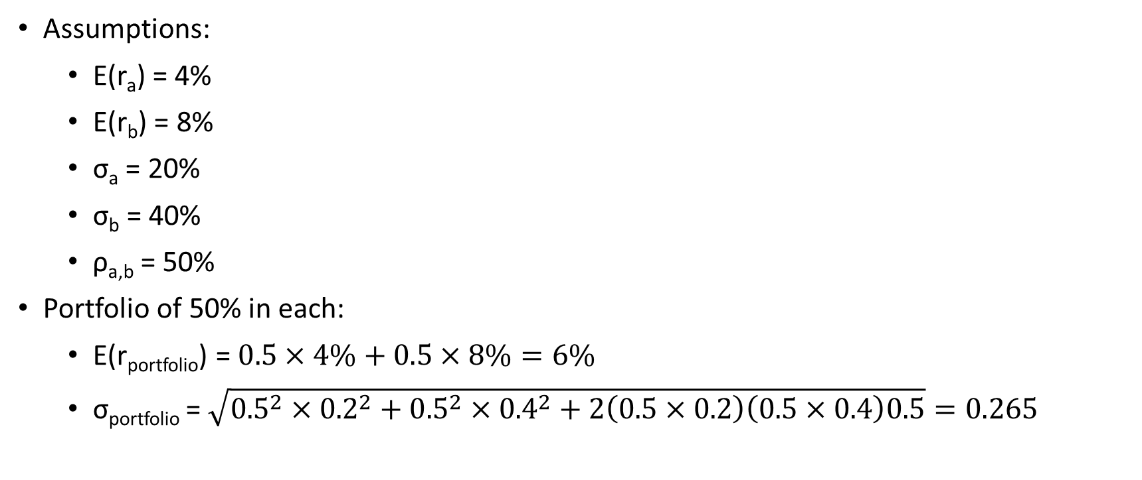
Example with Two Securities
Assumptions:
  E(r_{a}) = 4%
  E(r_{b}) = 8%
  σ_{a} = 20%
  σ_{b} = 40%
  ρ_{a,b} = 50%
Portfolio of 50% in each:
  E(r_{portfolio}) = $0.5×4\%+0.5×8\%=6\%$
  σ_{portfolio} = $\sqrt{{0.5}^{2}×{0.2}^{2}+{0.5}^{2}×{0.4}^{2}+2\left(0.5×0.2\right)\left(0.5×0.4\right)0.5}=0.265$
Average is 30%
Compare

Slide 14
Example (cont’d.)

Slide 15
Example (cont’d.)

Slide 16
Combinations of Two Risky Securities
SPECIAL CASE

Slide 17
Combinations of a Risky and a Risk-Free Security
SPECIAL CASE

Slide 18
Combinations of Three Risky Securities

Slide 19
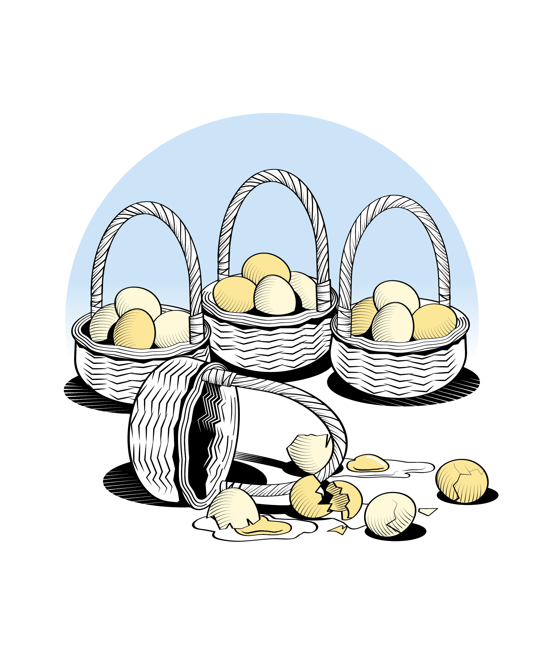
Implication
Investors should hold portfolios of many securities from widely different sectors.
Or the simplified version: Do not put all your eggs in one basket.

Slide 20


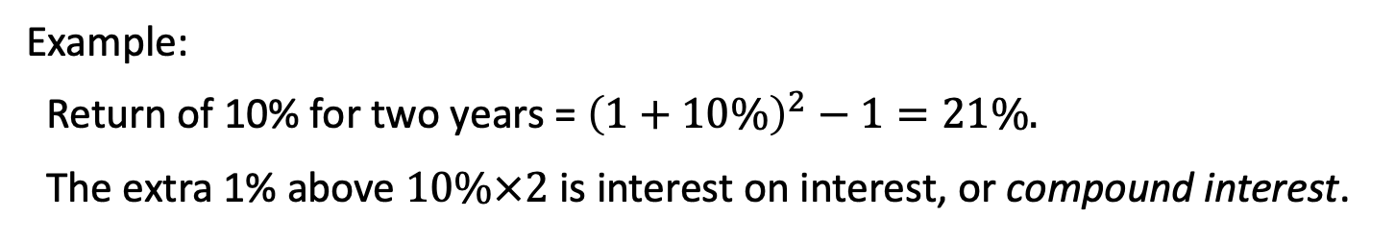
Expected Return over Time
Estimating the return over time (compounding):
$$Return for n periods=\left(1+r_{1}\right)×\left(1+r_{2}\right)×⋯×\left(1+r_{n}\right)−1$$
Or if the returns are the same in each period:
$$Return for n periods={\left(1+r\right)}^{n}−1$$
Example:
Return of 10% for two years = ${\left(1+10\%\right)}^{2}−1=21\%.$
The extra 1% above $10\%×2$ is interest on interest, or compound interest.
“Compound interest is the eighth wonder of the world. He who understands it, earns it, he who doesn’t, pays it.” Albert Einstein.

Slide 21
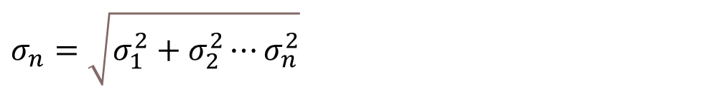
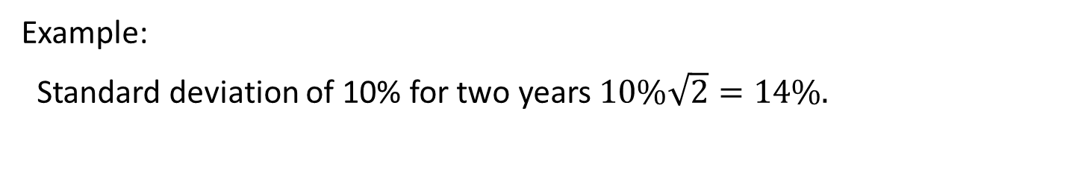
Standard Deviation over Time
Estimating the variance of return over time:
$$σ_{n}^{2}=σ_{1}^{2}+σ_{2}^{2}⋯σ_{n}^{2}$$
Thus, estimating the standard deviation of return over time:
$$σ_{n}=\sqrt{σ_{1}^{2}+σ_{2}^{2}⋯σ_{n}^{2}}$$
Or if the standard deviations are the same in each period:
$$σ_{n}=σ\sqrt{n}$$
Example:
Standard deviation of 10% for two years $10\%\sqrt{2}=14\%.$

Slide 22


Return and Standard Deviation over Time
$$Return for n periods={\left(1+r\right)}^{n}−1$$
Compound interest
$$σ_{n}=σ\sqrt{n}$$

Slide 23
Implication
The longer the investment horizon, the riskier the investment should be.
IMPORTANT

Slide 24
Simulations

Slide 25
The S&P 500 vs T-Bills

Slide 26
Summary
σ is lower for some combination of securities than the lowest σ of the individual securities, provided that the correlation between the securities is imperfect.
  Implication: Diversification allows us to remove risk and attain a lower σ.
σ is increasing at a decreasing rate over time.
  Implication: If we invest in the long-run, we should be more willing to invest in risky securities.
Return
σ
σ
t

Slide 27
Implications for Portfolio Choice
Diversification (already noted)
Risk and investment horizon (already noted)
How to attain a portfolio with the desired risk level → next slides
σ
Diversifiable
risk
Total portfolio risk
Systematic risk
Number of securities in portfolio

Slide 28
Efficient Frontier with Three Securities

Slide 29
Efficient Frontier for All Stocks & Risk-Free Security
→ we should all invest in a combination of the risk-free security and the market portfolio

Slide 30
Reasonable Portfolios

Slide 31

Concept Test 1
Not in book
A financial advisor promotes her business as follows:
The lower the risk tolerance of the client, the more diversified portfolio we will choose for the client.
The higher the risk tolerance of the client, the more we will concentrate the risk in individual stocks and bonds.
What do you think?
Notes:
This is based on a real case. I disagree with this promotion. All clients should have a diversified portfolio. Those with greater risk tolerance should invest a larger portion of their diversified portfolio in stocks (and a smaller portion in bonds) than those with smaller risk tolerance.

Slide 32
Concept Test 2
Not in book
Sue is suing her financial advisor for bad investment advice.
She started her relationship with the advisor a decade ago when she had already accumulated a diversified portfolio of stocks and bonds across a 401(k) plan (with $600,000) and her personal brokerage account (with $150,000). The financial advisor recommended that she invest half the money in her personal brokerage account in some obscure and risky companies, which she did. Several of these companies turned out to perform very poorly, which triggered her to launch the lawsuit. Sue (and the expert that her lawyer hired to assist in the lawsuit) argues that the recommended investments were far too risky for her, and, therefore, not suitable for her portfolio.
To support her claim, she estimated the standard deviation of returns for each of these investments to all exceed 60%, compared to the standard deviation of returns for the rest of her portfolio as a whole of about 15%.
Do you agree with Sue’s argument?
Notes:
This is based on real cases.
Sue ignores the correlation across investments. Depending on the magnitude of the correlation, it is likely that much (and probably even more than half) of the standard deviation of the obscure companies washes out when held as part of a diversified portfolio.

Slide 33
Concept Test 3
Not in book
Ned has no need for investment income (i.e., cash flow from interest and dividends), so he avoids all fixed income securities and even stocks that pay dividends.
What do you think?
Notes:
Ned misses out on diversification opportunities (because non-dividend paying stocks tend to be clustered in certain high-growth sectors) and easy ways to dial down risk (by, e.g., investing in safe fixed income securities). So, it might be better to just accept that some securities come with interest payments and dividends to obtain the proper level of diversification and risk.

Slide 34
Concept Test 4
Not in book
Suppose that you are advising a 25-year-old client about how to invest her inheritance of $200,000 for the long-term (i.e., at least 30 years). Your client has a steady job but no significant other assets.
  Your client is very risk-averse, so she would prefer to invest in a low-risk index fund with an expected annual return of 3.5% and a standard deviation of returns of 4.2%. Explain to her why it would make more sense for her to invest in a diversified equity portfolio with an expected return of 10.5% and a standard deviation of returns of 18%.
  Suppose instead that your client expects to spend the money to buy a house within the next few years. How would your investment advice change?
Notes:
Over the long-term, she will do at least as well (even in the worst-case scenario) with the high-risk portfolio, so that is the better choice.
With the shorter investment horizon, she should dial down the risk by investing at least partially in the low-risk index fund.

Slide 35
Concept Test 5
Not in book
Suppose you have identified two stocks, both with an expected return of 11% and a standard deviation of returns of 55%, and the correlation between their returns is 50%.
  If you hold a portfolio of 50% in each of the two stocks, will the expected return be more, less, or equal to 11%?
  If you hold a portfolio of 50% in each of the two stocks, will the standard deviation of returns be more, less, or equal to 55%?
Notes:
Same
Less

